Slide 1
Hashing

Slide 2
Preview
A hash function is a function that:
When applied to an Object, returns a number
When applied to equal Objects, returns the same number for each
When applied to unequal Objects, is very unlikely to return the same number for each
Hash functions turn out to be very important for searching, that is, looking things up fast
This is their story....

Slide 3
What are your ideas?
If we needed a data structure to be able to add, delete, and find items, what would you suggest?
What is the complexity of each of these

Slide 4
What are your ideas?
If we needed a data structure to be able to add, delete, and find items, what would you suggest?
What is the complexity of each of these
What ways could you use to implement a dictionary? Ordered array
Unordered array
Ordered linked list
Binary search tree

Slide 5
Method | Insert time | Search Time
Ordered array | n/2 | log n
Unordered array | 1 | n/2
Ordered linked list | n/2 | n/2
Binary search tree | log n | log n
What if log n is too long? Can we do better?

Slide 6
Hashing
Suppose we were to come up with a “magic function” that, given a value to search for, would tell us exactly where in the array to look
If it’s in that location, it’s in the array
If it’s not in that location, it’s not in the array
This function would have no other purpose
If we look at the function’s outputs, they probably won’t “make sense”
This function is called a hash function because it “makes hash” of its inputs

Slide 7
Example (ideal) hash function
Suppose our hash function gave us the following values:
hashCode("apple") = 5 hashCode("watermelon") = 3 hashCode("grapes") = 8 hashCode("cantaloupe") = 7 hashCode("kiwi") = 0 hashCode("strawberry") = 9 hashCode("mango") = 6 hashCode("banana") = 2
0
1
2
3
4
5
6
7
8
9
kiwi
banana
watermelon
apple
mango
cantaloupe
grapes
strawberry

Slide 8
Sets and tables
Sometimes we just want a set of things—objects are either in it, or they are not in it
Sometimes we want a map or dictionary—a way of looking up one thing based on the value of another
We use a key to find a place in the map
The associated value is the information we are trying to look up
Hashing works the same for both sets and maps
Most of our examples will be sets
. . .
141
142
143
144
145
146
147
148
key value
robin
robin info
sparrow
sparrow info
hawk
hawk info
seagull
seagull info
bluejay
bluejay info
owl
owl info

Slide 9
Finding the hash function
How can we come up with this magic function?
In general, we cannot--there is no such magic function ☹
In a few specific cases, where all the possible values are known in advance, it has been possible to compute a perfect hash function
What is the next best thing?
A perfect hash function would tell us exactly where to look
We deal with collisions when we have them.

Slide 10
How hard is it to find a good hash function?
Consider the birthday paradox – the chances of two people in a room having the same birthdates?
23 people – 50%
60 people – greater than 99%

Slide 11
Hash Function 1 – Adding Characters
unsigned int hash(string key)
{unsigned int hashVal = 0;
for (int i=0; i < key.length(); i++)
hashVal += key[i];
return hashVal % TABLESIZE;
}
We treat the characters of the key as numbers. When we add them, we actually get their ASCII value (A = 65, etc.).
Is this a good way?

Slide 12
Hash Function 2 – Slide and add
unsigned int hash(string key)
{ unsigned int hashVal=0;
for (i=0; i < key.length(); i++)
hashVal = (hashVal * 128 +key[i]) % TABLESIZE;
return hashVal;
}
This is better as it uses a broader range of values.
If the number gets too large to store, it throws away most significant bits. Unsigned int is 65535 in max size.

Slide 13
Bit operations
unsigned int x
What does this do?
x << 5
What does ^ do?
The caret (^) is an exclusive or. Exclusive ors work at the bit level in the following way:
10110110
11001100
-------------
01111010

Slide 14
Hash Function 3
unsigned int hash(string key)
{unsigned int hashVal=0;
for (i=0; i < key.length(); i++)
hashVal = (hashVal << 5) ^ key[i] ^ hashVal;
return hashVal %TABLESIZE;
}
Since we use or to put the original hashVal back in, we aren’t in danger of losing the effect of the first characters

Slide 15
These are good hash functions. For board work, I’ll use something easy (such as val%tablesize) so we can compute the hash value in our heads.

Slide 16
Example imperfect hash function
Suppose our hash function gave us the following values:
hash("apple") = 5 hash("watermelon") = 3 hash("grapes") = 8 hash("cantaloupe") = 7 hash("kiwi") = 0 hash("strawberry") = 9 hash("mango") = 6 hash("banana") = 2 hash("honeydew") = 6
0
1
2
3
4
5
6
7
8
9
kiwi
banana
watermelon
apple
mango
cantaloupe
grapes
strawberry
• Now what?

Slide 17
Collisions
When two values hash to the same array location, this is called a collision
Collisions are normally treated as “first come, first served”—the first value that hashes to the location gets it
We have to find something to do with the second and subsequent values that hash to this same location

Slide 18
Handling collisions
What can we do when two different values attempt to occupy the same place in an array?
Solution #1: Search from desired spot for an empty location (with wrap)
Will we ever be able to find the values again?
Solution #2: Try again with a second hash function
...and a third, and a fourth, and a fifth, ... to find a better location. How many hash functions would we need????
Solution #3: Create a linked list of values that hash to this location
All these solutions work, provided:
We use the same technique to add things to the array as we use to find things in the array

Slide 19
Finding an empty spot
How would you choose an empty spot?
How would the item ever be located again?

Slide 20
Linear Probing
Use a vacant spot in table following HASH(key) – “open” addressing means that we find an unused address and use it.
Evaluation
Longer search times
Clustering gets worse and worse (snowballs).
Primary clustering is when two keys that hash onto different values compete for same locations in successive hashes.
Better if successive probe locations are picked in “scrambled” order to lessen clustering.

Slide 21
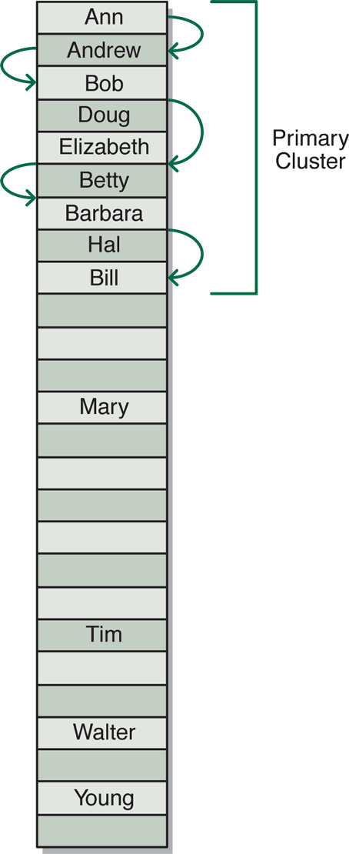
Open Addressing
Linear probing – if an element hashes to position p and that position is occupied, try position (p+1)%s where s is the size of the table
One problem with linear probing is the development of clusters of occupied cells
Example: Ann, Andrew, Bob, Doug, Elizabeth, Betty, Barbara, Hal, Bill.

Slide 22
Linear Probing Example: Key%TableSize
Key Desired Hash Loc
5 5
53 15
35 16
56 18
92 16
15 15
62 5
73 16
55 17
142 9
0 | 55
1
2
3
4
5 | 5
6 | 62
7
8
9 | 142
10
11
12
13
14
15 | 53
16 | 35
17 | 16
18 | 73

Slide 23
Clustering
One problem with the “linear probing” is the tendency to form “clusters”
A cluster is a group of items not containing any open slots
The bigger a cluster gets, the more likely it is that new values will hash into the cluster, and make it ever bigger
Clusters cause efficiency to degrade
Here is a non-solution: instead of stepping one ahead, step n locations ahead
The clusters are still there, they’re just harder to see
Unless n and the table size are mutually prime, some table locations are never checked

Slide 24
Quadratic Probing
Assume the value of the hash function is H = HASH(i). Cells are probed according to H, H+ 1² , H+ 2² ,
H+ 3² , H+ 4² ,H+ 5² ,
What would advantage of this be?
Note:
May miss some locations (not find one when one exists).
Can do without multiplication – see the book for more information

Slide 25
Hash Location | Difference from Previous | What is formula
H | 0 | diff=1
H+1 | 1 | H=H+diff
H+4 | 3 | diff = diff+2
H+9 | 5
H+16 | 7
H+25 | 9
H+36 | 11

Slide 26
Quadratic Probing
Is primary clustering eliminated? (Do keys that hash to different locations compete for the same sequence of successive locations?)
Secondary clustering is when different keys that hash to same locations compete for successive hash locations.
Quadratic probing eliminates primary clustering, but not secondary clustering.

Slide 27
Double Hashing (Personalized Increment)
For both linear and quadratic probing, the sequences checked are key independent.
Two different keys which hash to same location, keep competing.
IDEA: Have two functions, Step gives the increment for Hash.
Define: Step(key) = 1 + key % (TABLESIZE - 2) – gives personalized increment.
Notice, the location of Step is never used directly as the hash value. It is only an auxiliary function.
If TABLESIZE and TABLESIZE–2 are primes, it works better.
Hash(key) = key % TABLESIZE
If Hash(key) is full, successively add increment as specified by Step(key).
For example for key = 38 and TABLESIZE = 13 What is the series of locations probed?

Slide 28
Double Hashing
For example for key = 38 and TABLESIZE = 13
= 1 + 38 % 11 = 6 – gives personalized increment.
= 38 % 13 = 12
= (12 + 6) % 13 = 5
= (5 + 6) % 13 = 11
= (11 + 6) % 13 = 4
= (4 + 6) % 13 = 10
= (10 + 6) % 13 = 3
= (3 + 6) % 13 = 9
= (9 + 6) % 13 = 2
= (2 + 6) % 13 = 8
= (8 + 6) % 13 = 1
= (1 + 6) % 13 = 7
= (7 + 6) % 13 = 0
= (0 + 6) % 13 = 6
Notice how hash values jump around over the range of possible values at what appears to be random.
Each of the probe sequences visits all the table locations if the size of the table and the size of the increment are relatively prime with respect to each other.

Slide 29
Buckets
Another way to handle collisions is to have each entry in the hash table hold more than one (B) item.
Each entry is called a bucket.
This doesn’t really solve the problem. As soon as the bucket fills up, you still have to deal with collisions.
I think it would be better to just have the original table B times as large.

Slide 30
Separate Chaining
Each location in the hash table is a pointer to a linked list of things that hashed to that location.
Advantages
Saves space if records are long
Collisions are no problem
Overflow is solved as space is dynamic
Deletion is easy
Disadvantages
Links require space
Following linked list is more time consuming
For example: HASH(key) = key % 7 with the data: 5 28 3 108 72 19
Works well, but we have the overhead of pointers.

Slide 31
Separate Chaining
. . .
141
142
143
144
145
146
147
148
. . .
2
14
83
364
54
226

Slide 32
What do you do when the array fills up? (Or after many deletions, the array is too big.)
Rehash – create a larger (or smaller) array. Rehash all old elements into new array.

Slide 33
Efficiency
Hash tables are actually surprisingly efficient
Until the table is about 70% full, the number of probes (places looked at in the table) is typically only 2 or 3
Sophisticated mathematical analysis is required to prove that the expected cost of inserting into a hash table, or looking something up in the hash table, is O(1)
Even if the table is nearly full (leading to occasional long searches), efficiency is usually still quite high

Slide 34
Deletions
So, how do we delete????

Slide 35
Deletions
For probing, an empty spot found during a find operation indicates not present.
Solution: use lazy deletion.
After a while, almost everything may be marked as “deleted”

Slide 36
Efficiency of Hashing
load factor = number-of-elements / TABLESIZE
Should not exceed 2/3.
With chaining, the concern is the average size of a chain.

Slide 37
Talking Points on Hashing
Properties of a good hash function
Minimize collisions
Fast to compute
Scatter data evenly through hash table. Data may have patterns to them.
Uses all bits of the key – generally helps in scattering non-random data
If mod is used, base should be prime
Chaining methods may be superior to probing, depends on cost of operations. Space expense of storage for links.
Advantages and disadvantages of hashing
Usually lower number of probes than comparison searches (like binary search tree), but could be bad for some sets of data
No order relationship: can’t print all items in order
Cannot look for items close to given key

Slide 38
Cuckoo Hashing
Cuckoo hashing worst-case constant lookup time.
The name derives from the behavior of some species of cuckoo, where the cuckoo chick pushes the other eggs or young out of the nest when it hatches; analogously, inserting a new key into a cuckoo hashing table may push an older key to a different location in the table.

Slide 39
Use two hash tables.
There are two hash functions, one for each table.
If a key can’t go in either location, it tries to move the existing key to its alternative spot in the other table.
When a new key is inserted, the new key is inserted in one of its two possible locations, "kicking out", that is, displacing, any key that might already reside in this location.
This displaced key is then inserted in its alternative location, again kicking out any key that might reside there, until a vacant position is found, or the procedure enters an infinite loop. In the latter case, the hash table is rebuilt in-place using new hash functions:

Slide 42
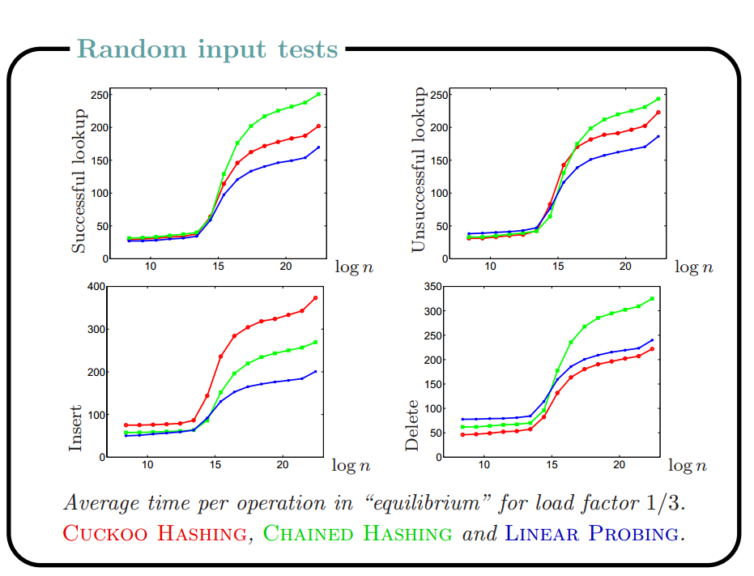
n is the number of elements in table

