Slide 1
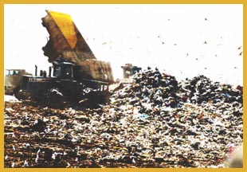
Chapter 6:
Priority Queues, AKA Heaps

Slide 2
Queues with special properties
Consider applications
  ordering CPU jobs
  searching for the exit in a maze (or looking for moves in the rotation puzzle game)
  emergency room admission processing
Goals
  short jobs should go first
  most promising nodes should be searched first
  most urgent cases should go first
  Anything greedy
Notes:
Alright, now we all remember what a tree is. Let’s harken back to queues now.
Here are some possible applications of a queue which aren’t quite right.
All of these want to favor certain entries in the Queue. How do we handle that?

Slide 3
Priority Queue ADT
Priority Queue operations
  create
  destroy
  insert
  deleteMin
  is_empty
Priority Queue property: for two elements in the queue, x and y, if x has a lower priority value than y, x will be deleted before y
F(7) E(5)
D(100) C(4)
B(6)
G(9)
insert
deleteMin
C(4)
Notes:
We need a new ADT for this. One that returns the best (which we’ll generally define as lowest priority value) node next.
I’m often going to represent priority queues as collections of priorities; remember that they are collections of data with priorities. MOREOVER, some priority queues don’t even need priorities, just the ability to compare priorities. (all of the ones we’ll talk about fall in this category).

Slide 4
Naïve Priority Queue Data Structures
Unsorted list:
Sorted list:
BST trees
Splay trees
AVL trees
We maintain total order, but that is more than we need. Can we benefit by keeping less information?
Notes:
OK, let’s look at some ways we might implement priority Qs.
Unsorted lists give us fast inserts, but we have to search the whole list to delete.
Sorted lists give us fast delete (it’s just the first element!), but we have to either search the whole list (for ll) or move the whole list (for array) on an instert.

Slide 5
Binary Heap Priority Queue Data Structure
Heap-order property (Min Tree)
  parent’s key is less than children’s keys
  result: minimum is always at the top
Structure property
  almost complete tree with leaf nodes packed to the left
  result: depth is always O(log n); next open location always known
2
4
5
7
6
10
8
11
9
12
14
20
How do we find the minimum?
Notes:
Alright, there are two problems with binary search trees as pqs.
First, they’re overkill. Why keep everything ordered? We just need to know the least at any given time.
Second, they’re not guaranteed to be complete, so we have worst case O(n) times.

Slide 6
Clever Storage Trick allows us to easily find parents/kids without pointers
Calculations:
  child:
  parent:
  root:
  next free:
0
2
1
2
4
5
3
4
5
6
7
6
10
8
11
9
12
14
20
7
8
9
10
11
0
1
2
3
4
5
6
7
8
9
10
11
12
2
4
5
7
6
10
8
11
9
12
14
20
Notes:
It so happens that we can store a complete tree in an array and still be able to find children and parents easily. We’ll take advantage of this.
Child:
left = 2*node
right = 2*node + 1
parent = floor(node/2)
root = 1
nextfree = length + 1

Slide 7
DeleteMin
pqueue.deleteMin()
2
2
20
4
5
4
5
7
6
10
8
7
6
10
8
11
9
12
14
20
11
9
12
14
20
Notes:
OK, to delete, we start by plucking out that value in O(1) time.
Now, we have a hole at the top, and a node that isn’t proper for a complete tree at the bottom.
So, we fix it by putting the value in the hole, and moving the hole until we restore the heap-order property.

Slide 8
Percolate Down
20
4
4
5
20
5
7
6
10
8
7
6
10
8
11
9
12
14
11
9
12
14
4
4
6
5
6
5
7
20
10
8
7
12
10
8
11
9
12
14
11
9
20
14

Slide 9
DeleteMin Code
Comparable deleteMin(){
x = A[0];
A[0]=A[size--];
percolateDown(0);
return x;
}
percolateDown(int hole) {
shiftVal=heap[hole];
while (2*hole+1 <= size) {
left = 2*hole+1;
right = left + 1;
if (right <= size &&
heap[right] < heap[left])
target = right;
else
target = left;
if (heap[target] < shiftVal) {
heap[hole] = heap[target];
hole = target;
}
else
break;
}
Heap [hole] = shiftVal;
}
Trick to avoid repeatedly copying the value at A[0]
Move down
runtime:
Notes:
Note that there are three things going on here: find the smaller child
if the smaller child is still smaller than the moving value, move the smaller child up
otherwise, we’ve found the right spot, and stop.

Slide 10
Insert – put node where the next node goes – to force shape.
pqueue.insert(3)
2
2
4
5
4
5
7
6
10
8
7
6
10
8
11
9
12
14
20
11
9
12
14
20
3
Notes:
Inserting works similarly. We tack a hole on at the end of the tree, and move that hole _up_ until it’s in the right place for the new value.

Slide 11
Percolate Up
2
2
4
5
4
5
7
6
10
8
7
6
3
8
11
9
12
14
20
3
11
9
12
14
20
10
2
4
3
7
6
5
8
11
9
12
14
20
10

Slide 12
Insert Code
void insert(Comparable newVal) {
// Efficiency hack: we won’t actually put newVal
// into the heap until we’ve located the position
// it goes in. This avoids having to copy it
// repeatedly during the percolate up.
int hole = ++size;
// Percolate up
for( ; hole>0 && newVal < heap[(hole-1)/2] ;
hole = (hole-1)/2)
heap[hole] = heap[(hole-1)/2];
heap[hole] = newVal;
}
runtime:
Notes:
Notice that this code is a _lot_ easier.

Slide 13
Performance of Binary Heap
 | Binary heap worst case | Binary heap avg case | AVL tree worst case | BST tree avg case
Insert | O(log n) | O(1) 2.6 compares | O(log n) | O(log n)
Delete Min | O(log n) | O(log n) | O(log n) | O(log n)
In practice: binary heaps much simpler to code, lower constant factor overhead
75% of all nodes are at bottom two levels.
If you insert nodes “somewhat” in order, you have a greater chance of being at a lower level.

Slide 14
Changing Priorities
In many applications the priority of an object in a priority queue may change over time
  if a job has been sitting in the printer queue for a long time increase its priority
  Since we can’t efficiently find things in a PQ, this is a problem.
Must have some (separate) way of find the position in the queue of the object to change (e.g. a hash table)

Slide 15
Other Priority Queue Operations
decreaseKey
  Given the position of an object in the queue, increase its priority (lower its key). Reheapify
increaseKey
  given the position of an object in the queue, decrease its priority (increase its key). Reheapify
remove
  given the position of an an object in the queue, remove it. Similar to removeMin
Notes:
Why do I insist on a pointer to each item in decreaseKey, increaseKey, and remove?
Because it’s hard to find an item in a heap; it’s easy to delete the minimum, but how would you find some arbitrary element?
This is where the Dictionary ADT and its various implementations which we will study soon come up.
What about build heap? Is that really a necessary operation?
It turns out that the necessity for this is based _purely_ on the fact that we can do it faster than the naïve implementation!

Slide 16
BuildHeap
Task: Given a set of n keys, build a heap all at once
Approach 1: Repeatedly perform Insert(key)
Complexity:

Slide 17

Build Min Heap
Floyd’s Method
12
5
11
3
10
6
9
4
8
1
7
2
pretend it’s a heap and fix the heap-order! What is complexity?
12
buildHeap(){
for (i=size/2; i>0; i--)
percolateDown(i);
}
5
11
3
10
6
9
4
8
1
7
2
Notes:
Pull other slide back up and ask how long it takes.
O(n log n) worst case, but O(n) average case.
Can we get a worst case O(n) bound?
Let’s try pretending it’s a heap already and just fixing the heap-order property.
The red nodes are the ones that are out of order.
Question: which nodes MIGHT be out of order in any heap?

Slide 18
Build Min Heap
12
12
5
11
5
11
3
10
2
9
3
1
2
9
4
8
1
7
6
4
8
10
7
6
12
12
5
2
1
2
3
1
6
9
3
5
6
9
4
8
10
7
11
4
8
10
7
11

Slide 19
Finally…
1
3
2
4
5
6
9
12
8
10
7
11
Notes:
How long does this take? Well, everything above the fringe might move 1 step.
Everything height 2 or greater might move 2 steps.
…
In other words n * Sum I=0 to n of I/2^{i}
But, this is (as n->inf) just 2. See chapter I to see why.
So, the runtime is O(n).

Slide 20
Complexity of Build Heap
Note: size of a perfect binary tree doubles with each additional layer
At most n/4 percolate down 1 level
at most n/8 percolate down 2 levels
at most n/16 percolate down 3 levels…
Because denominator is growing so fast, sum is bounded by 2
O(n)
Notes:
Comp

Slide 21
Heap Sort
Input: unordered array A[0..N]
  Build a max heap (largest element is A[0])
  For i = 0 to N-1:
  A[N-i] = Delete_Max()
7
50
22
15
4
40
20
10
35
25
50
40
20
25
35
15
10
22
4
7
40
35
20
25
7
15
10
22
4
50
35
25
20
22
7
15
10
4
40
50

Slide 22
Properties of Heap Sort
Worst case time complexity O(n log n)
  Build_heap O(n)
  n Delete_Max’s for O(n log n)
In-place sort – only constant storage beyond the array is needed ( no recursion)

Slide 23
Thinking about Heaps
Observations
  finding a child/parent index is a multiply/divide by two
  each percolate down operation looks at only two kids
  inserts are at least as common as deleteMins
Realities
  division and multiplication by powers of two are fast
  with huge data sets (that can’t be stored in main memory), memory accesses dominate
Notes:
Now, let’s look at some facts about heaps and see if we can’t come up with a new priority queue implementation.

Slide 24
Solution: d-Heaps
Each node has d children
Still representable by array
Good choices for d:
  optimize performance based on # of inserts/removes
  power of two for efficiency
  fit one set of children in a cache line (the block of memory that is transferred to memory cache)
  fit one set of children on a memory page/disk block
1
3
7
2
4
8
5
12
11
10
6
9
1
3
7
2
4
8
5
12
11
10
6
9
Notes:
D-heaps address all these problems.

Slide 25
Merging?
Different scholarship PQs which need to merge after certain deadlines.
This would not be efficient with an AVL tree or a heap (stored as an array). We need a new idea.

Slide 26
New Operation: Merge
Merge(H1,H2): Merge two heaps H1 and H2 of size O(N).
  E.g. Combine queues from two different sources
  Can do O(N) Insert operations: O(N log N) time
  Better: Copy H2 at the end of H1 (assuming array implementation) and use Floyd’s Method for BuildHeap.
  Running Time: O(N)
  Can we do even better with a different data structure? (i.e. Merge in O(log N) time?)

Slide 27
Mergeable Priority Queues:
Leftist and Skew Heaps
Leftist Heaps: Binary heap-ordered trees with left subtrees always “longer” than right subtrees
  Main idea: Recursively work on right path for Merge/Insert/DeleteMin
  Right path is always short → has O(log N) nodes
  Merge, Insert, DeleteMin all have O(log N) running time (see text)
Skew Heaps: Self-adjusting version of leftist heaps (a la splay trees)
  Do not actually keep track of path lengths
  Adjust tree by swapping children during each merge
  O(log N) amortized time per operation for a sequence of M operations

Slide 28
Leftist Heaps
A heap structure that enables fast merges
Notes:
What if you had networked printers or CPUs and one of them went down.
Now you want to merge the priority queues!
How can we do that?
Here’s two naïve ways.
1st attempt: If the two trees are the same size: O(n log n)
2nd attempt: O(n) (that’s how long buildHeap takse)

Slide 29
Definition: Null Path Length
the null path length (npl) of a node is the smallest number of nodes between it and a null in the tree
npl(null) = -1
npl(leaf) = 0
npl(single-child node) = 0
2
3
1
7
4
1
0
9
13
1
6
0
8
0
another way of looking at it:
npl is the height of complete subtree rooted at this node
0
0
15
19
9
0
Notes:
Before I make this more concrete, let’s get a totally unrelated random definition that we probably will never use.
Note that I’m assuming a binary tree here.
Null path length is the number of nodes between a given node and a null.
Npl of null is -1
npl of a leaf or a node with just one child is 0
Notice that I’m putting the null path length, NOT the values in the nodes.

Slide 30
Leftist Heap Properties
Heap-order property
  parent’s priority value is ≤ to childrens’ priority values
  result: minimum element is at the root
Leftist property
  null path length of left subtree is ≥ npl of right subtree
  result: tree is at least as “heavy” on the left as the right
Are leftist trees complete? Balanced?
Notes:
So, here are the formal properties of a leftist heap.
Heap-order, of course.
And, the leftist property; this means that the npl of the right child is never greater than that of the left child.
Are leftist trees necessarily complete or balanced? NO. In fact, a _great_ leftist tree is a string of nodes all on the left!

Slide 31
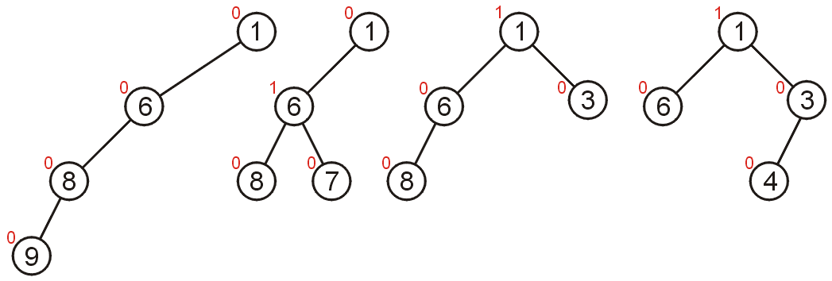
All leftist trees with 4 nodes

Slide 32
Leftist tree examples
NOT leftist
leftist
leftist
2
2
0
1
1
1
1
0
0
1
0
0
1
0
0
0
1
0
0
0
0
0
0
0
0
0
every subtree of a leftist
tree is leftist!
0
0
Notes:
Here are some training examples to help you learn.
The red nodes break the leftist property for the first tree.
The other two trees are leftist.

Slide 33
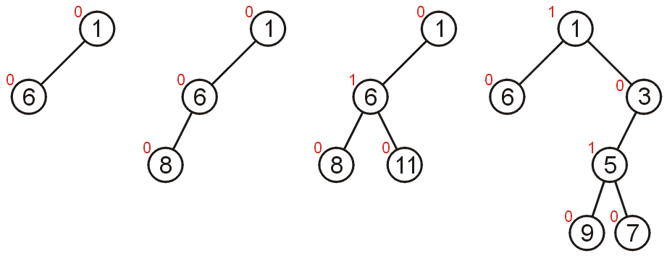
Are these leftist?
(not always visually what you expect)

Slide 34
Right Path in a Leftist Tree is Short
2
If the right path has length
at least r, the tree has at
least 2^{r} - 1 nodes
Proof by induction
Basis: r = 1. Tree has at least one node: 2¹ - 1 = 1
Inductive step: assume true for r’ < r. The right subtree has a right path of at least r - 1 nodes, so it has at least 2^{r - 1} - 1 nodes. The left subtree must also have a right path of at least r - 1 (otherwise, there is a null path of r - 3, less than the right subtree). Again, the left has 2^{r - 1} - 1 nodes. All told then, there are at least:
2^{r - 1} - 1 + 2^{r - 1} - 1 + 1 = 2^{r} - 1
Basically, the shortest path must be to the right. So, if you always take the shortest path, it can’t be longer than log n.
1
1
1
0
0
0
0
0
0
Notes:
Why do we have this leftist property?
Because it guarantees that the right path is really short compared to the number of nodes in the tree without being as stodgy as the heap structure property.
Here’s a proof which boils down to the fact that if the left path is r long, the null path length must be at least r (otherwise somewhere along there, there’s a node with a larger right npl than left).
Since the tree is complete at least to depth r, there are at least 2^{r} - 1 nodes in the tree.

Slide 35
Merging
As there is no relation between the nodes in the sub-trees of a heap:
  If both the left and right sub-trees are leftist heaps but the root does not form a leftist heap, We only need to swap the two sub-trees
  We can use this to merge two leftist heaps

Slide 36
Merging strategy: Given two leftist heaps, recursively merge the larger value with the right sub-heap of the root
Traversing back to the root, swap trees to maintain the leftist heap property
Node * merge (Node * t1, Node * t2) // t1 and t2 are merged, new tree is created
{ Node * small;
if (t1==NULL) return t2;
if (t2==NULL) return t1;
if (t1 ->element < t2->element) {
t1->right = merge(t1->right, t2);
small=t1;}
else {
t2->right = merge(t2->right, t1);
small=t2;}
if (notLeftist(small)) swapkids(small);
setNullPathLength(small);
return small;
}
// How is notLeftist determined? It is a separate routine because a child may be Null (so examining t->left->nullpathlength is problematic)

Slide 37
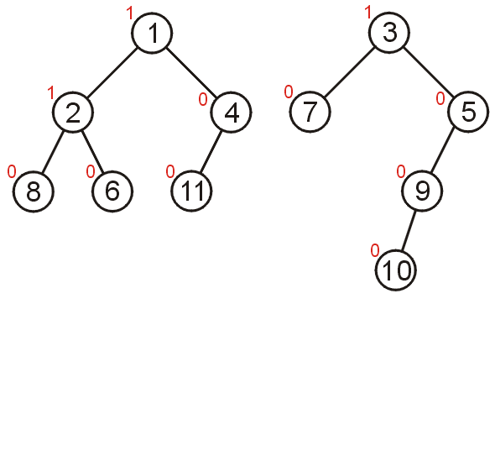
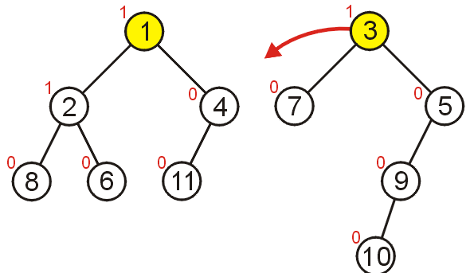
Consider merging these two leftist min heaps

Slide 38
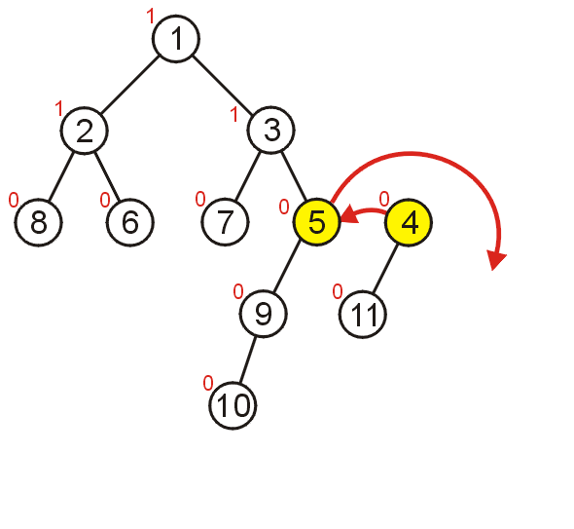
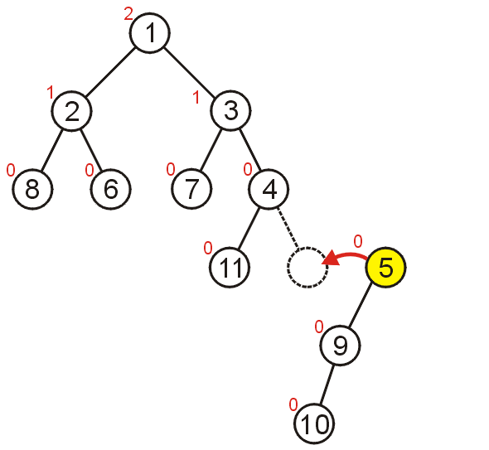
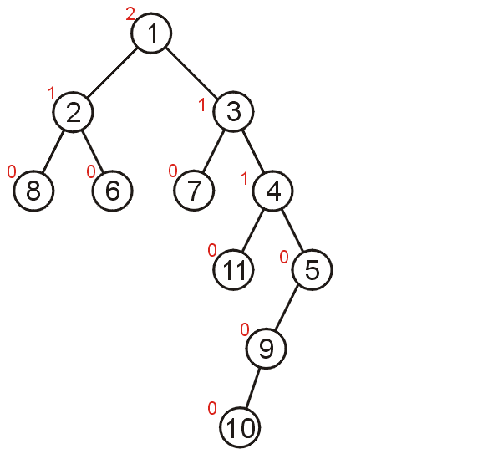

Slide 39
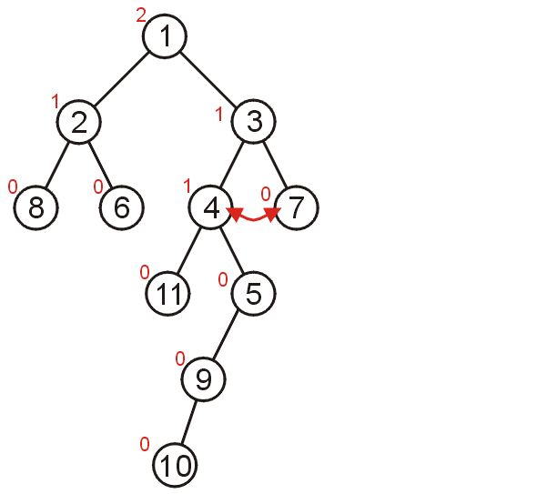
The heaps are merged, but the result is not a leftist heap as 3 is unhappy.
On the way back our of the recursion swap sub-heaps where necessary. Find the unhappy nodes – after updating the null path lengths.

Slide 40
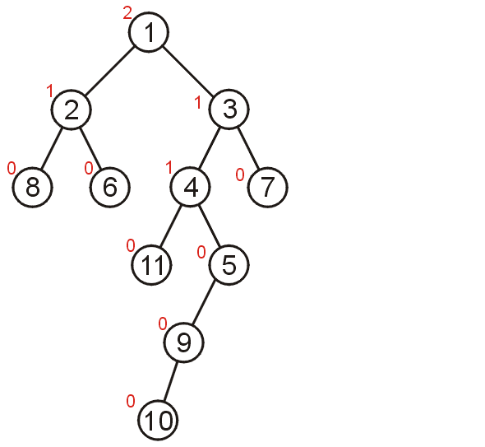
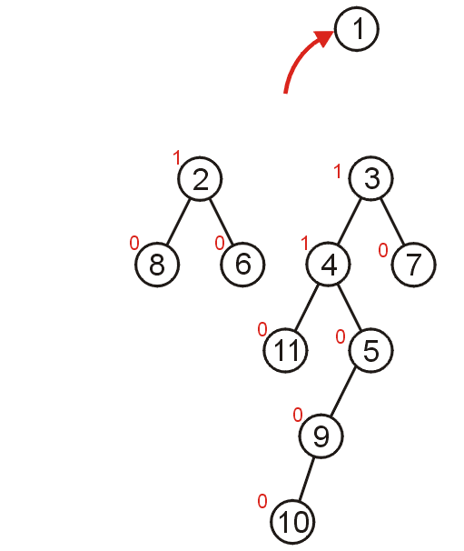
Delete Min

Slide 41
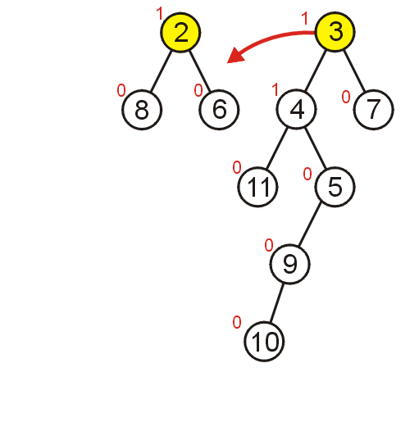
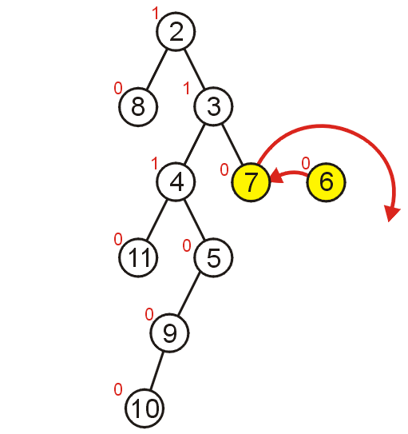
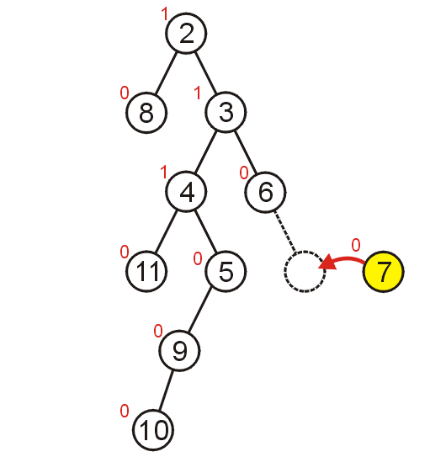
Who is unhappy?

Slide 42
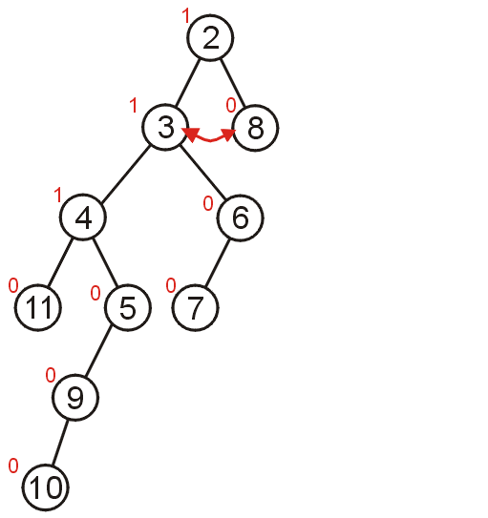
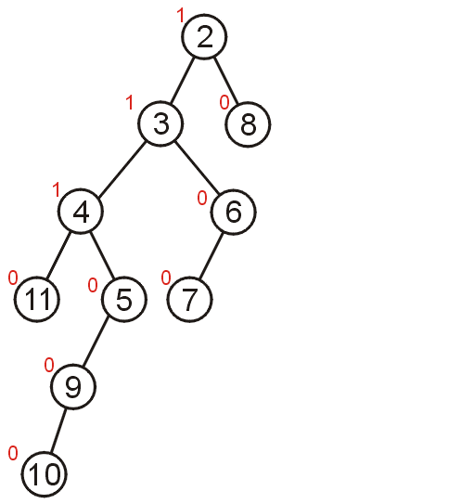
6 has already switched kids
Only nodes on access path can be unhappy, right?

Slide 43
Operations on Leftist Heaps
Everything is a merge
merge with two trees of total size n: O(log n)
insert with heap size n: O(log n)
  pretend node is a size 1 leftist heap
  insert by merging original heap with one node heap
deleteMin with heap size n: O(log n)
  remove and return root
  merge left and right subtrees
merge
merge
Notes:
Now that we have that wicked merge op. Let’s just use it to implement all the other ops.
Is one node a size one leftist heap?

Slide 44
Example
merge
1
?
5
3
0
merge
0
0
7
10
12
1
?
5
5
1
0
3
14
0
0
0
merge
10
12
10
0
0
0
12
7
8
0
0
8
8
0
14
0
8
0
12
Notes:
Alright, let’s try an example.
I’m unwinding the recursion here.
I pulled a fast one merging the last two nodes. I could have reduced that to merging a node with null (which is clearly the original node) but I didn’t for convenience.
Don’t _you_ do that on tests!

Slide 45
Putting together the pieces
?
?
1
3
3
3
0
0
0
7
?
7
1
7
5
1
5
5
0
0
0
0
0
14
0
0
14
0
0
14
10
8
10
8
10
8
0
0
0
12
12
12
Not leftist
Notes:
No, we need to put the example back together, fixing the leftist property as we go.
Are we done here?
NO!
The root’s right child has a higher npl than its left child!

Slide 46
Finally…
1
1
3
3
0
0
7
5
1
5
1
7
0
0
0
0
0
0
14
10
8
10
8
14
0
0
12
12
Notes:
So, we swap the root’s children.
Is the final tree a leftist heap?

Slide 47
Skew Heaps
Problems with leftist heaps
  extra storage for npl
  extra complexity/logic to maintain and check npl
Solution: skew heaps
  blind adjusting version of leftist heaps
  amortized time for merge, insert, and deleteMin is O(log n)
  worst case time for all three is O(n)
  merge always switches children when fixing right path
  iterative method has only one pass
What do skew heaps remind us of?
Notes:
There are some problems with leftist heaps.
We’ll use skew heaps to fix those problems.
Motivation? Remember that we “often” get heavy right sides when we merge.
So, why not just assume the right side is heavy and move it over automatically?

Slide 48
The Skew Heap – A Simple Modification
We can make a simple modification to the leftist heap and get similar results without storing (or computing) the null path length.
We always merge with the right child, but after merging, we swap the left and right children for every node in the resulting right path of the temporary tree.

Slide 49
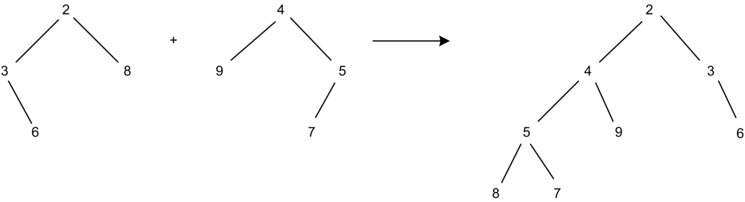
Try this one – do all merging first, then swap kids.
You should get the result on the right.

Slide 50
Let’s consider this operation from a recursive point of view. Let L be the tree with the smaller root and R be the other tree.
  If one tree is empty, the other is the merged result.
  If t is the tree with the smaller value, Let t->right = merge (t->right, other)
  Swap the kids of t
The result of child swapping is that the length of the right path will not be unduly large all the time.
The amortized time needed to merge two skew heaps is O(log n).

Slide 51
Node * SkewHeapMerge (Node * t1, Node * t2) // t1 and t2 are merged, a new tree
{ Node * small;
if (t1==NULL) return t2;
if (t2==NULL) return t1;
if (t1 ->element < t2->element) {
t1->right = merge(t1->right, t2);
small=t1;}
else {
t2->right = merge(t2->right, t1);
small=t2;}
swapkids(small);
return small;
}

Slide 52
Notice, only nodes on access path swap kids. Doorbell rings…

Slide 53
Binomial Queues
Binomial queues support all three priority queue operations Merge, Insert and DeleteMin in O(log N) time
Idea: Maintain a collection of heap-ordered trees
  Forest of binomial trees
Recursive Definition of Binomial Tree (based on height k):
  Only one binomial tree for a given height
  Binomial tree of height 0 = single root node
  Binomial tree of height k = B_{k} = Attach B_{k-1} to root of another B_{k-1}

Slide 54
Building a Binomial Tree
To construct a binomial tree B_{k} of height k:
  Take the binomial tree B_{k-1} of height k-1
  Place another copy of B_{k-1} one level below the first
  Attach the root nodes
Binomial tree of height k has exactly 2^{k} nodes (by induction)
B₀ B₁ B₂ B₃
5

Slide 55
Building a Binomial Tree
To construct a binomial tree B_{k} of height k:
  Take the binomial tree B_{k-1} of height k-1
  Place another copy of B_{k-1} one level below the first
  Attach the root nodes
Binomial tree of height k has exactly 2^{k} nodes (by induction)
B₀ B₁ B₂ B₃
5
3
9

Slide 56
Building a Binomial Tree
To construct a binomial tree B_{k} of height k:
  Take the binomial tree B_{k-1} of height k-1
  Place another copy of B_{k-1} one level below the first
  Attach the root nodes
Binomial tree of height k has exactly 2^{k} nodes (by induction)
B₀ B₁ B₂ B₃
5
3
4
9
6
7
12

Slide 57
Building a Binomial Tree
To construct a binomial tree B_{k} of height k:
  Take the binomial tree B_{k-1} of height k-1
  Place another copy of B_{k-1} one level below the first
  Attach the root nodes
Binomial tree of height k has exactly 2^{k} nodes (by induction)
B₀ B₁ B₂ B₃
5
3
4
1
9
6
7
2
15
8
12
20
10
11
14

Slide 58
Why termed Binomial?
Why are these trees called binomial?
  Hint: how many nodes at depth d?
B₀ B₁ B₂ B₃

Slide 59
Why Binomial?
Why are these trees called binomial?
  Hint: how many nodes at depth d?
Number of nodes at different depths d for B_{k} =
[1], [1 1], [1 2 1], [1 3 3 1], …
Binomial coefficients of (a + b)^{k} = k!/((k-d)!d!)
B₀ B₁ B₂ B₃

Slide 60
Definition of Binomial Queues
Binomial Queue = “forest” of heap-ordered binomial trees. Not all trees need to be present in queue
B₀ B₂ B₀ B₁ B₃
5
21
1
-1
3
9
7
2
1
3
6
8
11
5
7
Binomial queue H1
5 elements = 101 base 2
→ B₂ B₀
Binomial queue H2
11 elements = 1011 base 2
→ B₃ B₁ B₀
6

Slide 61
Binomial Queue Properties
Suppose you are given a binomial queue of N nodes
There is a unique set of needed binomial tree sizes for N nodes
What is the maximum number of trees that can be in an N-node queue?
  1 node → 1 tree B₀; 2 nodes → 1 tree B₁; 3 nodes → 2 trees B₀ and B₁; 7 nodes → 3 trees B₀, B₁ and B₂ …
  Trees B₀, B₁, …, B_{k} can store up to 2⁰ + 2¹ + … + 2^{k} = 2^{k+1} – 1 nodes = N.
  Maximum is when all trees are used. So, solve for (k+1).
  Number of trees is ≤ log(N+1) = O(log N)

Slide 62
Binomial Queues: Merge
Main Idea: Merge two binomial queues by merging individual binomial trees
  Since B_{k+1} is just two B_{k}’s attached together, merging trees is easy
Steps for creating new queue by merging:
  Start with B_{k} for smallest k in either queue.
  If only one B_{k}, add B_{k} to new queue and go to next k.
  Merge two B_{k}’s to get new B_{k+1} by making larger root the child of smaller root. Go to step 2 with k = k + 1.

Slide 63
Example: Binomial Queue Merge
H1: H2:
21
1
-1
3
5
7
2
1
3
9
6
8
11
5
7
6

Slide 64
Example: Binomial Queue Merge
H1: H2:
1
-1
3
5
7
2
1
3
21
9
6
8
11
5
7
6

Slide 65
Example: Binomial Queue Merge
H1: H2:
1
-1
5
7
3
2
1
3
9
6
21
8
11
5
7
6

Slide 66
Example: Binomial Queue Merge
H1: H2:
1
-1
7
3
5
2
1
3
21
9
6
8
11
5
7
6

Slide 67
Example: Binomial Queue Merge
H1: H2:
-1
2
1
3
1
8
11
5
7
3
5
6
21
9
6
7

Slide 68
Example: Binomial Queue Merge
H1: H2:
-1
2
1
3
1
8
11
5
7
3
5
6
21
9
6
7

Slide 69
Binomial Queues: Merge and Insert
What is the run time for Merge of two O(N) queues?
How would you insert a new item into the queue?

Slide 70
Binomial Queues: Merge and Insert
What is the run time for Merge of two O(N) queues?
  O(number of trees) = O(log N)
How would you insert a new item into the queue?
  Create a single node queue B₀ with new item and merge with existing queue
  Again, O(log N) time
Example: Insert 1, 2, 3, …,7 into an empty binomial queue

Slide 71
Insert 1,2,…,7
1

Slide 72
Insert 1,2,…,7
1
2

Slide 73
Insert 1,2,…,7
1
3
2

Slide 74
Insert 1,2,…,7
1
3
2
4

Slide 75
Insert 1,2,…,7
1
2
3
4

Slide 76
Insert 1,2,…,7
1
5
2
3
4

Slide 77
Insert 1,2,…,7
1
5
2
3
6
4

Slide 78
Insert 1,2,…,7
1
5
7
2
3
6
4

Slide 79
Binomial Queues: DeleteMin
Steps:
  Find tree B_{k} with the smallest root
  Remove B_{k} from the queue
  Delete root of B_{k} (return this value); You now have a new queue made up of the forest B₀, B₁, …, B_{k-1}
  Merge this queue with remainder of the original (from step 2)
Run time analysis: Step 1 is O(log N), step 2 and 3 are O(1), and step 4 is O(log N). Total time = O(log N)
Example: Insert 1, 2, …, 7 into empty queue and DeleteMin

Slide 80
Insert 1,2,…,7
1
5
7
2
3
6
4

Slide 81
DeleteMin Have to look at all roots.
1
5
7
2
3
6
4

Slide 82
DeleteMin Orphan kids (who form a binomial queue)
5
7
2
3
6
4

Slide 83
Merge
5
2
3
6
7
4

Slide 84
Merge Now, can join any two
5
2
3
6
7
4

Slide 85
Merge
5
2
6
7
3
4
DONE!

Slide 86
Implementation of Binomial Queues
Need to be able to scan through all trees, and given two binomial queues find trees that are same size
  Use array of pointers to root nodes, B_{k} stored at cell k
  Since is only of length log(N), don’t have to worry about cost of copying this array
  At each node, keep track of the max subtree rooted at that node
Want to merge by just setting pointers
  Need pointer-based implementation of heaps
DeleteMin requires fast access to all subtrees of root
  Use First-Child/Next-Sibling representation of trees

Slide 87
Implementation of Binomial Queues
If we didn’t want to worry about arrays of children
  Use First-Child/Next-Sibling representation of trees
  This next picture shows the largest child first. I would have the smallest child first, but the idea is the same.

Slide 88
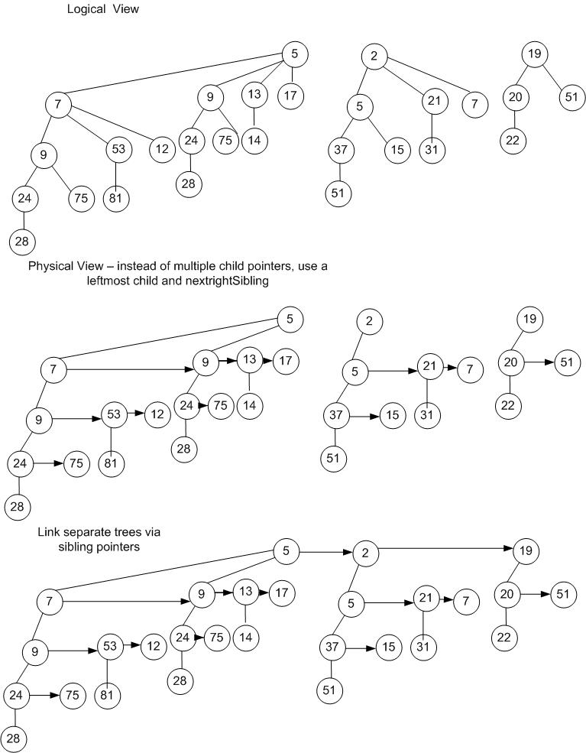

Slide 89
Efficient BuildHeap for Binomial Queues
Brute force Insert one at a time - O(n log n)
Better algorithm:
  Start with each element as a singleton tree
  Merge trees of size 1
  Merge trees of size 2
  Merge trees of size 4
Complexity:

Slide 90
Comparing Heaps - at seats pros/cons
AVL tree as PQ
Binary Heaps
d-Heaps
Binomial Queues
Leftist Heaps
Skew Heaps
Notes:
OK, I said you were being cheated unless you got a comparison of data structures. Who can tell me some good things about each of these?
Binary: simple, memory efficient, fast, can run buildHeap. cannot merge quickly.
d: Faster than binary heaps. Possibly much faster in some applications. Slightly more complicated. Otherwise, all binary advantages.
Leftist: supports merge quickly. Supports all other operations asymptotically quickly. Practically, extra storage, link traversals and recursion make it bigger and slower.
Skew: slightly less storage, somewhat faster and simpler than leftist. NOT guaranteed fast on EVERY operation (but guaranteed amortized speed.
Binomial queues? Never heard of ‘em. Read up on them in your book!

