Slide 1
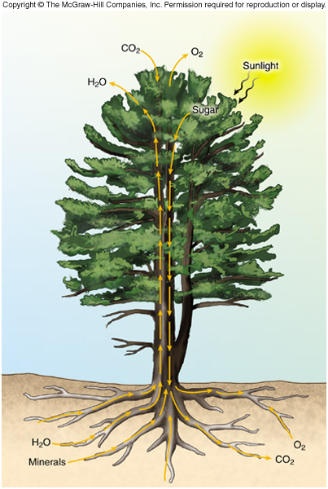
Transpiration (Dingman P 294)
Absorption of soil water by roots
Translocation through plant vascular system
Stomata open to take in CO₂ for photosynthesis and water is lost by transpiration
Plants control stomata openings to regulate photosynthesis and transpiration
from http://www.trunity.net/envsciClone/articles/view/177351/?topic=81575

Slide 2
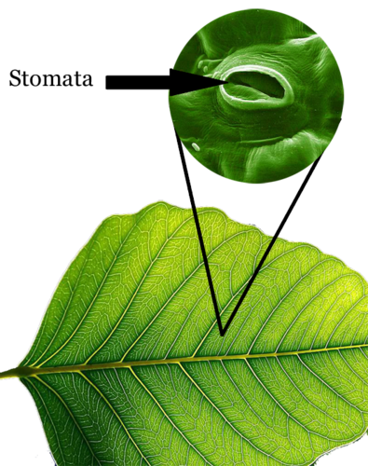
Stomata respond to
Light
Humidity
Water content (related to soil moisture)
Temperature
Other factors such as wind, CO₂, chemicals
from http://www.ck12.org/

Slide 3
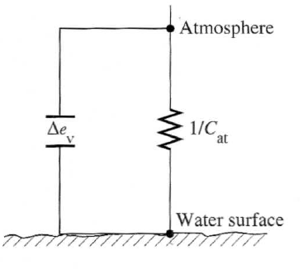
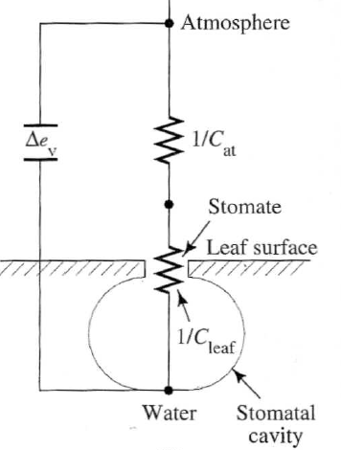
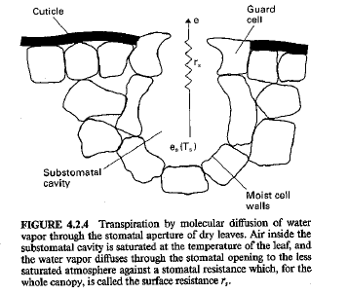
Canopy and atmospheric conductance
Resistance Analogy
$$E= K_{at} { C}_{at} \left(e_{s}−e_{a}\right)$$
$$ET=K_{at} C_{effective} \left(e_{s}−e_{a}\right)$$
$$\frac{1}{C_{effective}}=\frac{1}{C_{at}}+\frac{1}{C_{can}}$$
$$C_{can}=f_{s}∙LAI∙C_{leaf}$$
from Shuttleworth 1993
from Dingman (2002)

Slide 4
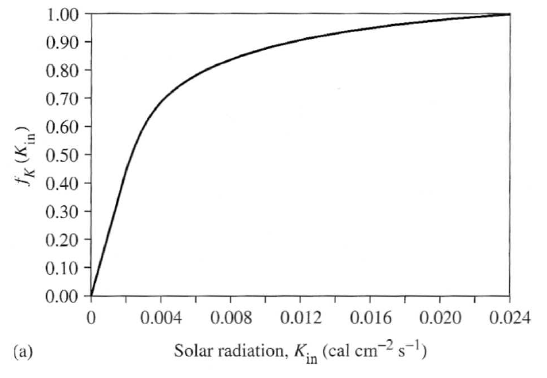
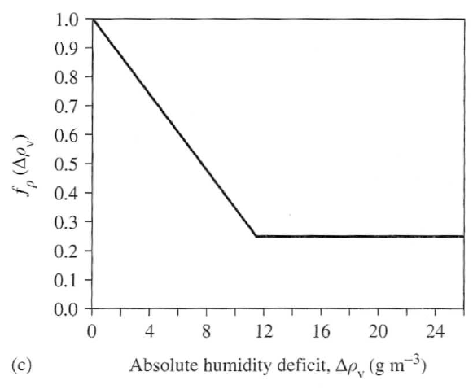
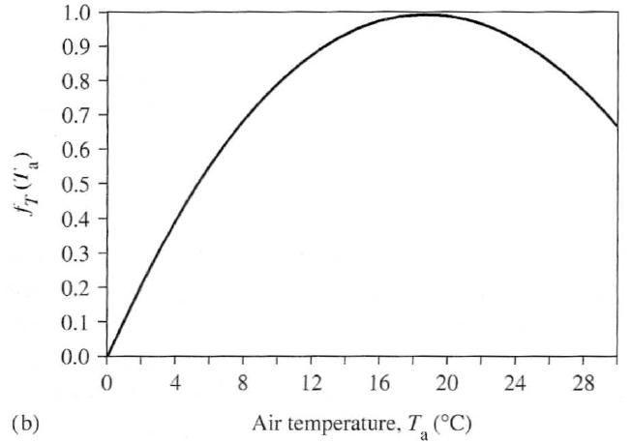
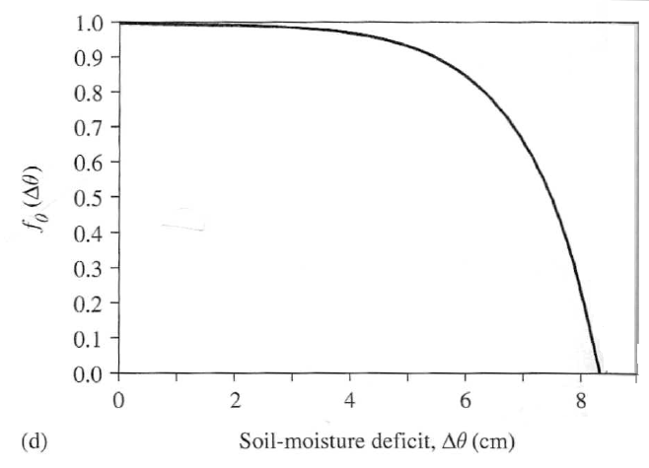
Leaf conductance functions
$$C_{leaf}=C_{leaf}^{∗}∙f_{K}\left(K_{in}\right)∙f_{ρ}(∆ρ_{v})∙f_{T}\left(T_{a}\right)∙f_{θ}(∆θ)$$
from Dingman (2002)

Slide 5
Penman-Monteith Model
$$E=\frac{∆∙\left(K+L\right)+ρ_{a}∙c_{a}{∙C}_{at}∙e_{a}^{∗}\left(1−W_{a}\right)}{ρ_{w}∙λ_{v}∙\left(∆+γ\right)}$$
Open water
$$ET=\frac{∆∙\left(K+L\right)+ρ_{a}∙c_{a}{∙C}_{at}∙e_{a}^{∗}\left(1−W_{a}\right)}{ρ_{w}∙λ_{v}∙\left(∆+γ∙\left(1+\frac{C_{at}}{C_{can}}\right)\right)}$$
Vegetation
$$ET=\frac{∆A+ρ_{a}∙c_{a}∙D/r_{a}}{ρ_{w}∙λ_{v}∙\left(∆+γ∙\left(1+\frac{r_{s}}{r_{a}}\right)\right)}$$
Shuttleworth 4.2.27 resistance notation
D = vapor pressure deficit
$$r_{s}=1/C_{can} r_{a}=1/{C_{at}}$$

Slide 6
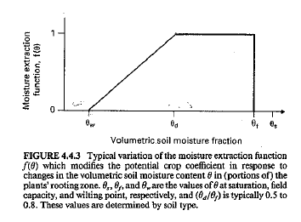
Soil moisture functions for actual ET
Common – consistent with “Crop factor” concept
$$ET=f\left(θ_{rel}\right)∙PET$$
Theoretically preferable based on resistance/conductance concept (Dingman 7-69)
$\frac{ET}{PET}=\frac{∆+γ∙\left(1+\frac{C_{at}}{C_{can}[f_{θ}\left(∆θ\right)=1]}\right)}{∆+γ∙\left(1+\frac{C_{at}}{C_{can}[f_{θ}\left(∆θ\right)]}\right)}$
from Shuttleworth 1993

Slide 7
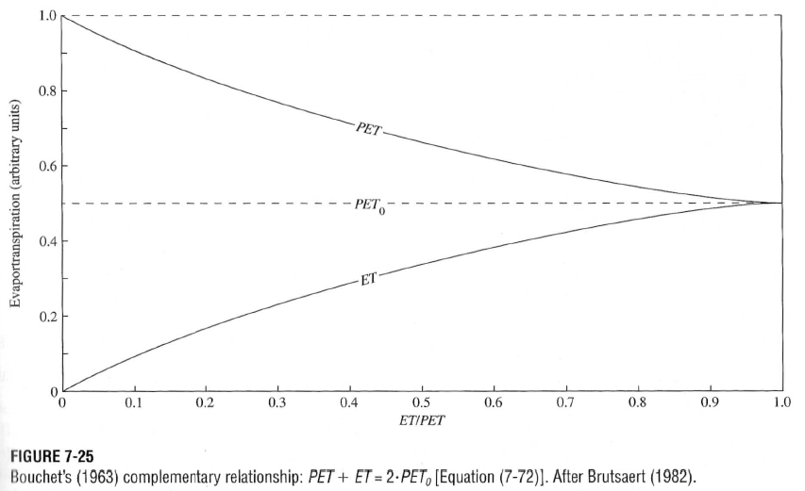
Complimentary (Advection-Aridity) Approach (Dingman p314)
from Dingman (2002)

