Slide 1
Evapotranspiration
Be able to calculate evaporation from open water surfaces and transpiration from vegetation, using a method appropriate for the information available

Slide 2
Water Balance Evaporation
$$E = P + SW_{in}+GW_{in}−SW_{out}−GW_{out}−∆V$$
Errors in quantifying the water balance terms all accumulate in the evaporation estimate

Slide 3
Standard Evaporation Rates
Potential Evaporation E_{o} [mm/day] is the quantity of water evaporated per unit area, per unit time from an idealized, extensive free water surface under existing atmospheric conditions.
Reference Crop Evaporation E_{rc} [mm/day] is the rate of evaporation from an idealized grass crop with a fixed crop height of 0.12 m, an albedo of 0.23, and a surface resistance of 69 s/m
These assume
No shortage of water
Ignore influence of evaporation on meteorological parameters
Actual Evaporation E [mm/day]
Refer to: Shuttleworth, W. J., (1993), "Evaporation," in Handbook of Hydrology, Chapter 4, Edited by D. R. Maidment, McGraw-Hill, New York.

Slide 4
ET involves
Energy exchanges and energy balance
Turbulent diffusion into the atmosphere
Adjustment and balance
+
R_{n}
+
-
-
-
+
G

Slide 5
Evaporative Energy Flux
MJ/kg
Evaporation rate E mm/day or m/s L/T
Mass evaporation rate ρ_{w}E kg/m²/day M L⁻² T⁻¹
Latent heat transfer rate
LE = λ_{v} ρ_{w}E kJ/m²/hr or W/m² E L⁻² T⁻¹

Slide 6
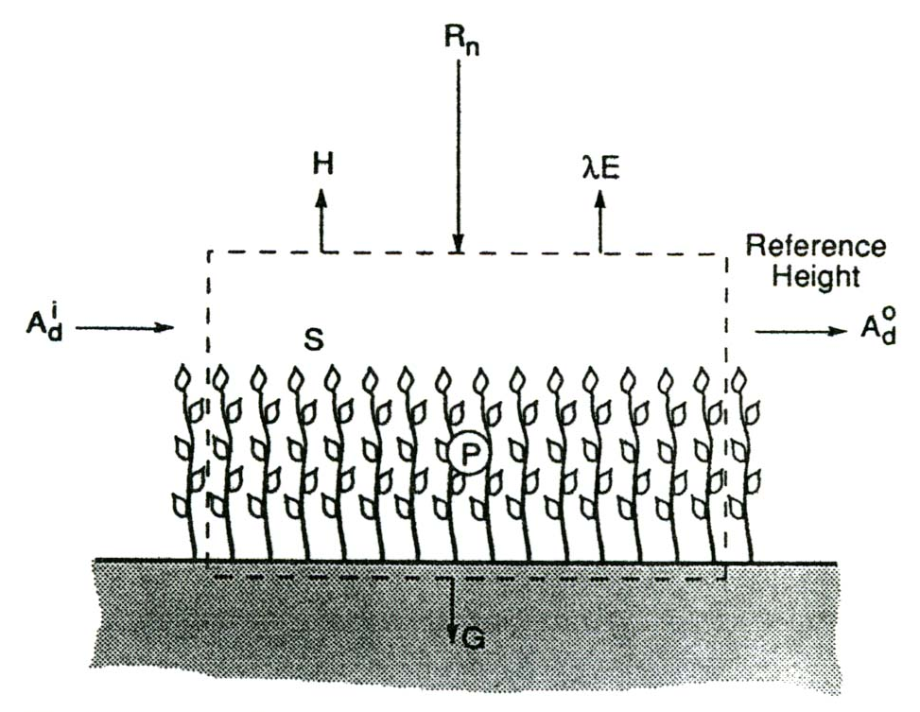
Energy Budget for a Unit Area
A = LE + H [MJ m⁻² day⁻¹]
A = R_{n} – G – S – P – A_{d}
Often
A = R_{n} – G
A_{d} – loss of energy associated with horizontal air movement. Significant in an “oasis” situation, generally neglected.
P – energy absorbed by biochemical processes in the plants, typically 2% of net radiation
R_{n} – net incoming radiation
LE – outgoing energy as evaporation
S – energy temporarily stored within the volume
G – outgoing heat conduction into the soil

Slide 7
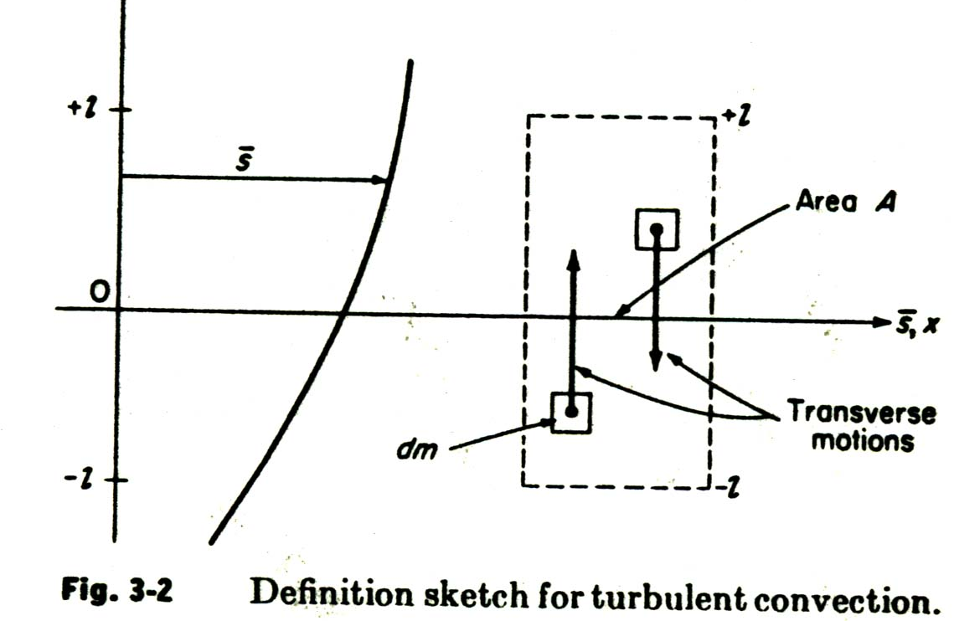
Turbulent transfer near the ground
$$v_{a}=\frac{1}{k}u_{∗}\ln\left(\frac{z−z_{d}}{z_{o}}\right)$$
$k$=0.4 von Karman
$$v_{a}$$
$${z_{d}≈0.7 z}_{veg}$$
$${z_{o}≈0.1 z}_{veg}$$
$$z_{d}$$
$$z_{o}$$
$$z_{veg}$$
From Chow et al., 1988

Slide 8
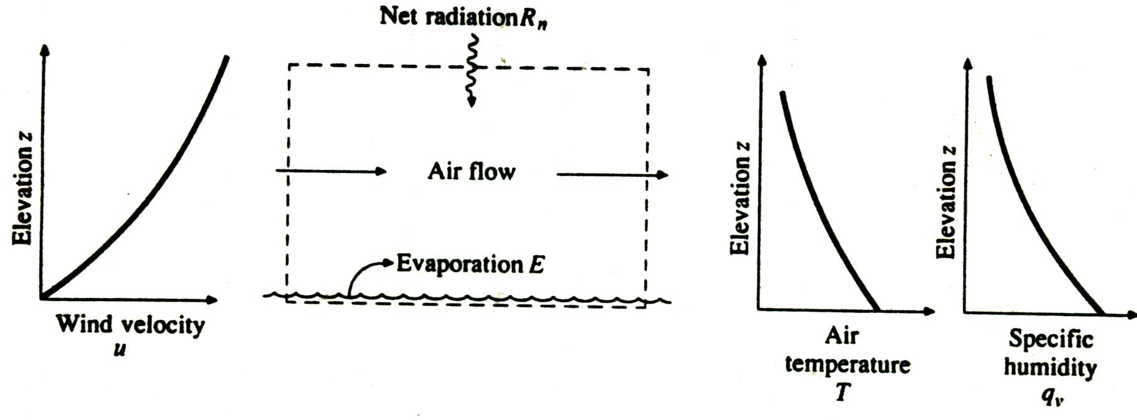
Turbulent convection transports heat, vapor and momentum
$$v_{a}$$
T_{a}
e_{a}
$$z_{m}$$
T_{s}
e_{s}

Slide 9
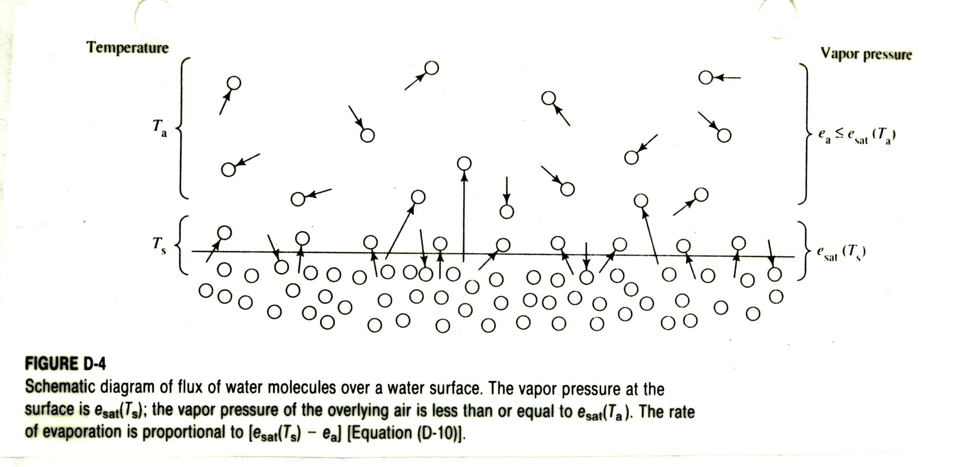
Vapor Transport
The vapor pressure at the surface is e_{s}(T_{s}); the vapor pressure of the overlying air is relative humidity times e_{s}(T_{a}). The rate of evaporation is proportional to e_{s} – e_{a}.
e_{s}(T_{a})
T_{d}
e_{a}
T_{a}

Slide 10
Mass Transfer / Aerodynamic Method

Slide 11
Bowen Ratio
γ- psychrometric constant
Using standard values for P and λ_{v} the value is 0.066 [kPa/K]

Slide 12
Bowen Ratio Energy Balance Method
A = R_{n} – G = LE + H = LE(1+β)

Slide 13
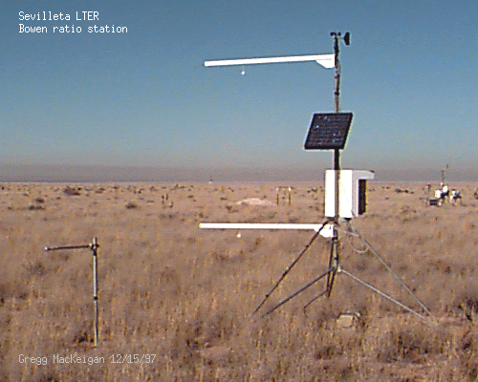

Slide 14
Combination Method Concepts
R_{n} – G = LE + H
e_{s}(T_{a})
e_{s}(T_{s})
T_{s}
T_{a}

Slide 15
Combination or Penman Method

Slide 16
Priestley Taylor Method
This is also sometimes taken as an estimate of equilibrium potential evapotranspiration for well watered surface

Slide 17
From Brutsaert, 2005

Slide 18
From Brutsaert, 2005

Slide 19
Summary of ET Equations
Bowen Ratio
Mass Transfer
Combination
Priestly Taylor
What happens in these equations if the wind speed doubles?

Slide 20
Evapotranspiration Feedbacks
+
R_{n}
+
-
-
-
+
G
Conditions adjust to varying inputs. Calculations can interpret adjustments, but should not be used to predict the effect of changing one variable without considering the adjustments of connected variables

Slide 21
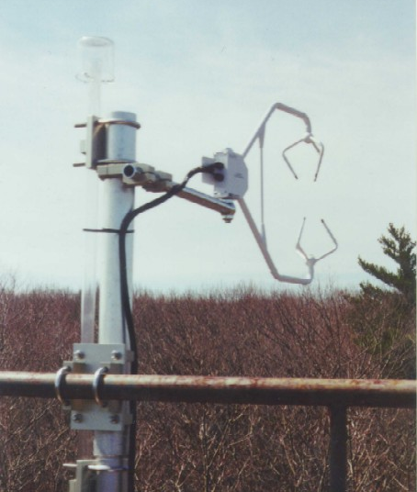
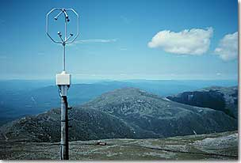
Eddy Correlation Approach
$$E \sim \overline{w′q′}$$
$w^{′}$ is vertical wind velocity component fluctuation
$q^{′}$ is specific humidity fluctuation

Slide 22
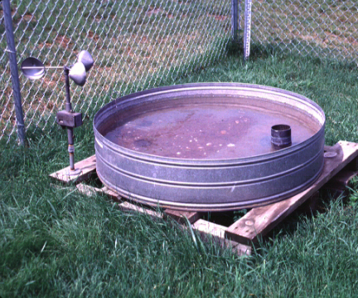
Evaporation Pan
U.S. Class A pan
1.21 m
255 mm
150 mm

Slide 23
Method Information Requirements
Mass Transfer
Bowen Ratio / Energy Balance
R_{N}
Combination

